Slide 1
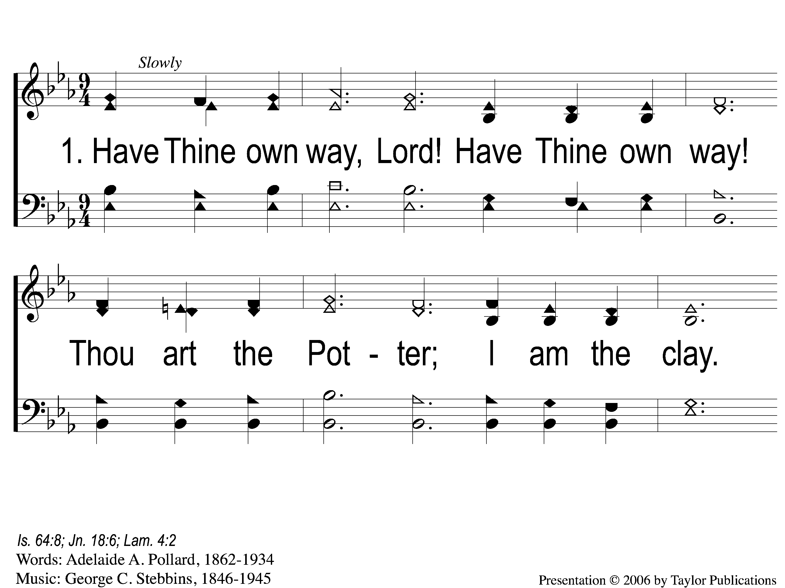
1-1 Have Thine Own Way
Have Thine Own Way
169

Slide 2
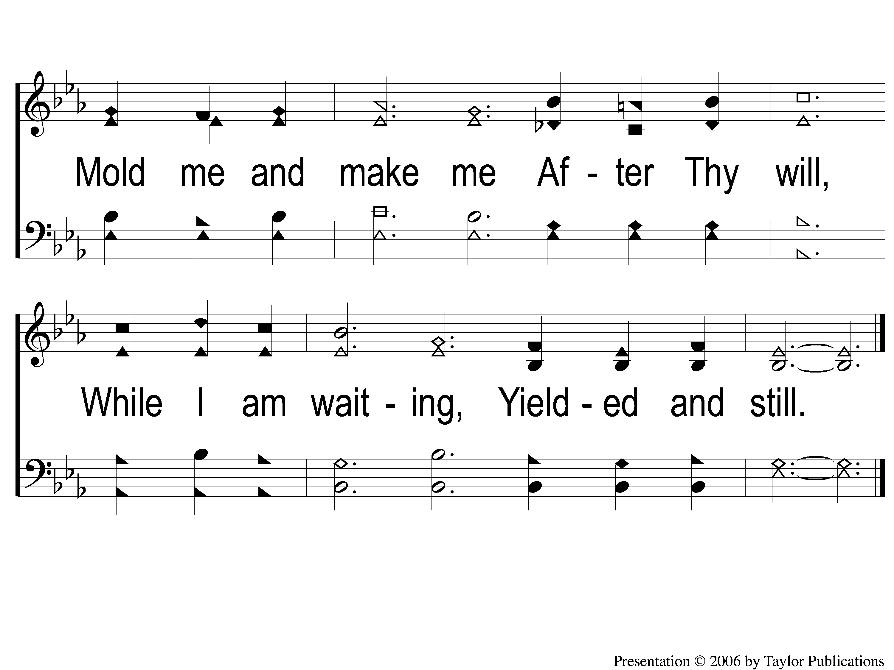
1-2 Have Thine Own Way
Have Thine Own Way
169

Slide 3
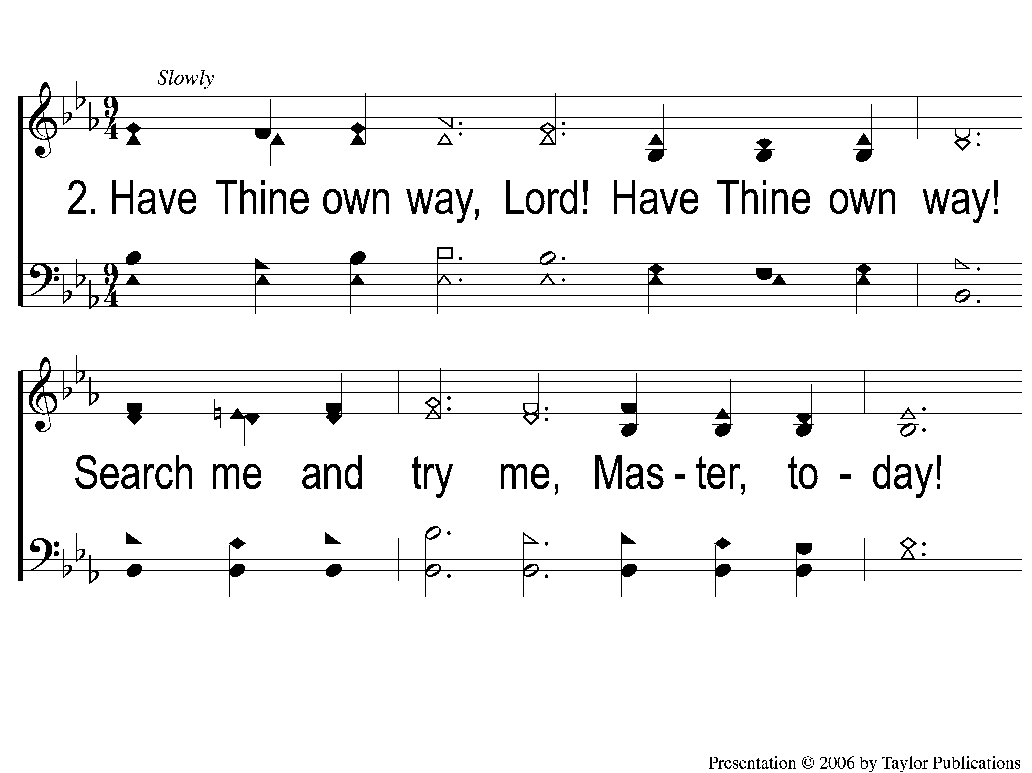
2-1 Have Thine Own Way
Have Thine Own Way
169

Slide 4
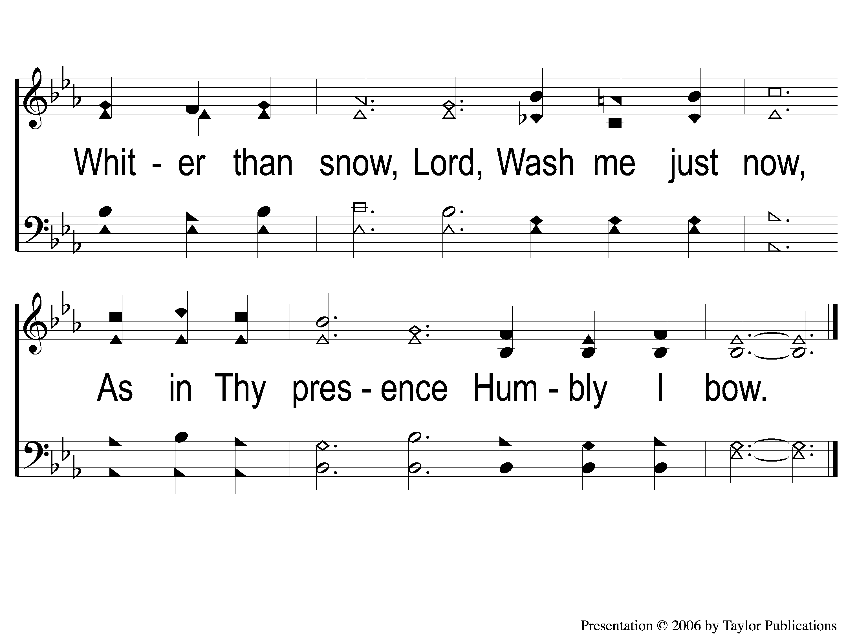
2-2 Have Thine Own Way
Have Thine Own Way
169

Slide 5
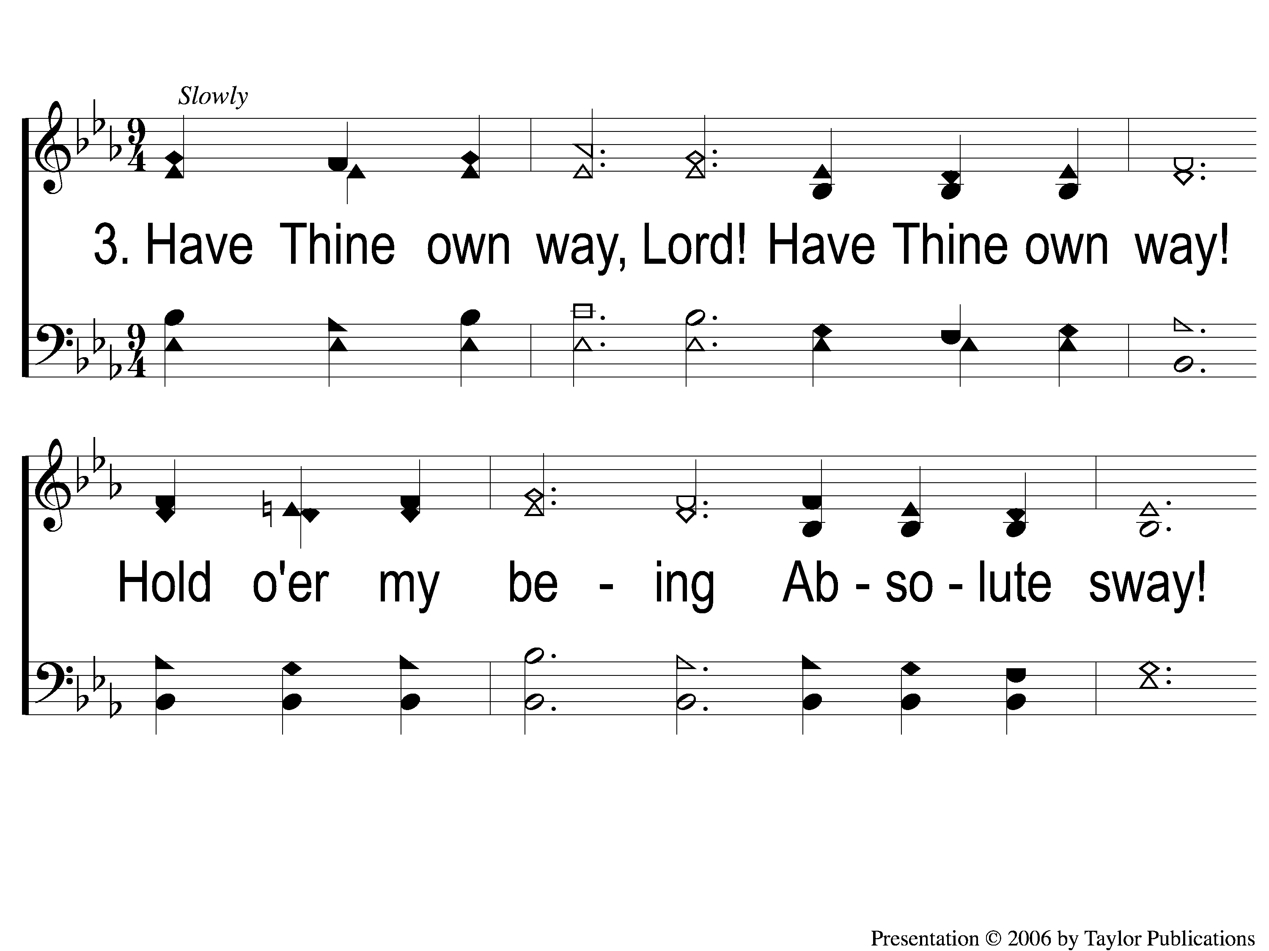
3-1 Have Thine Own Way
Have Thine Own Way
169

Slide 6
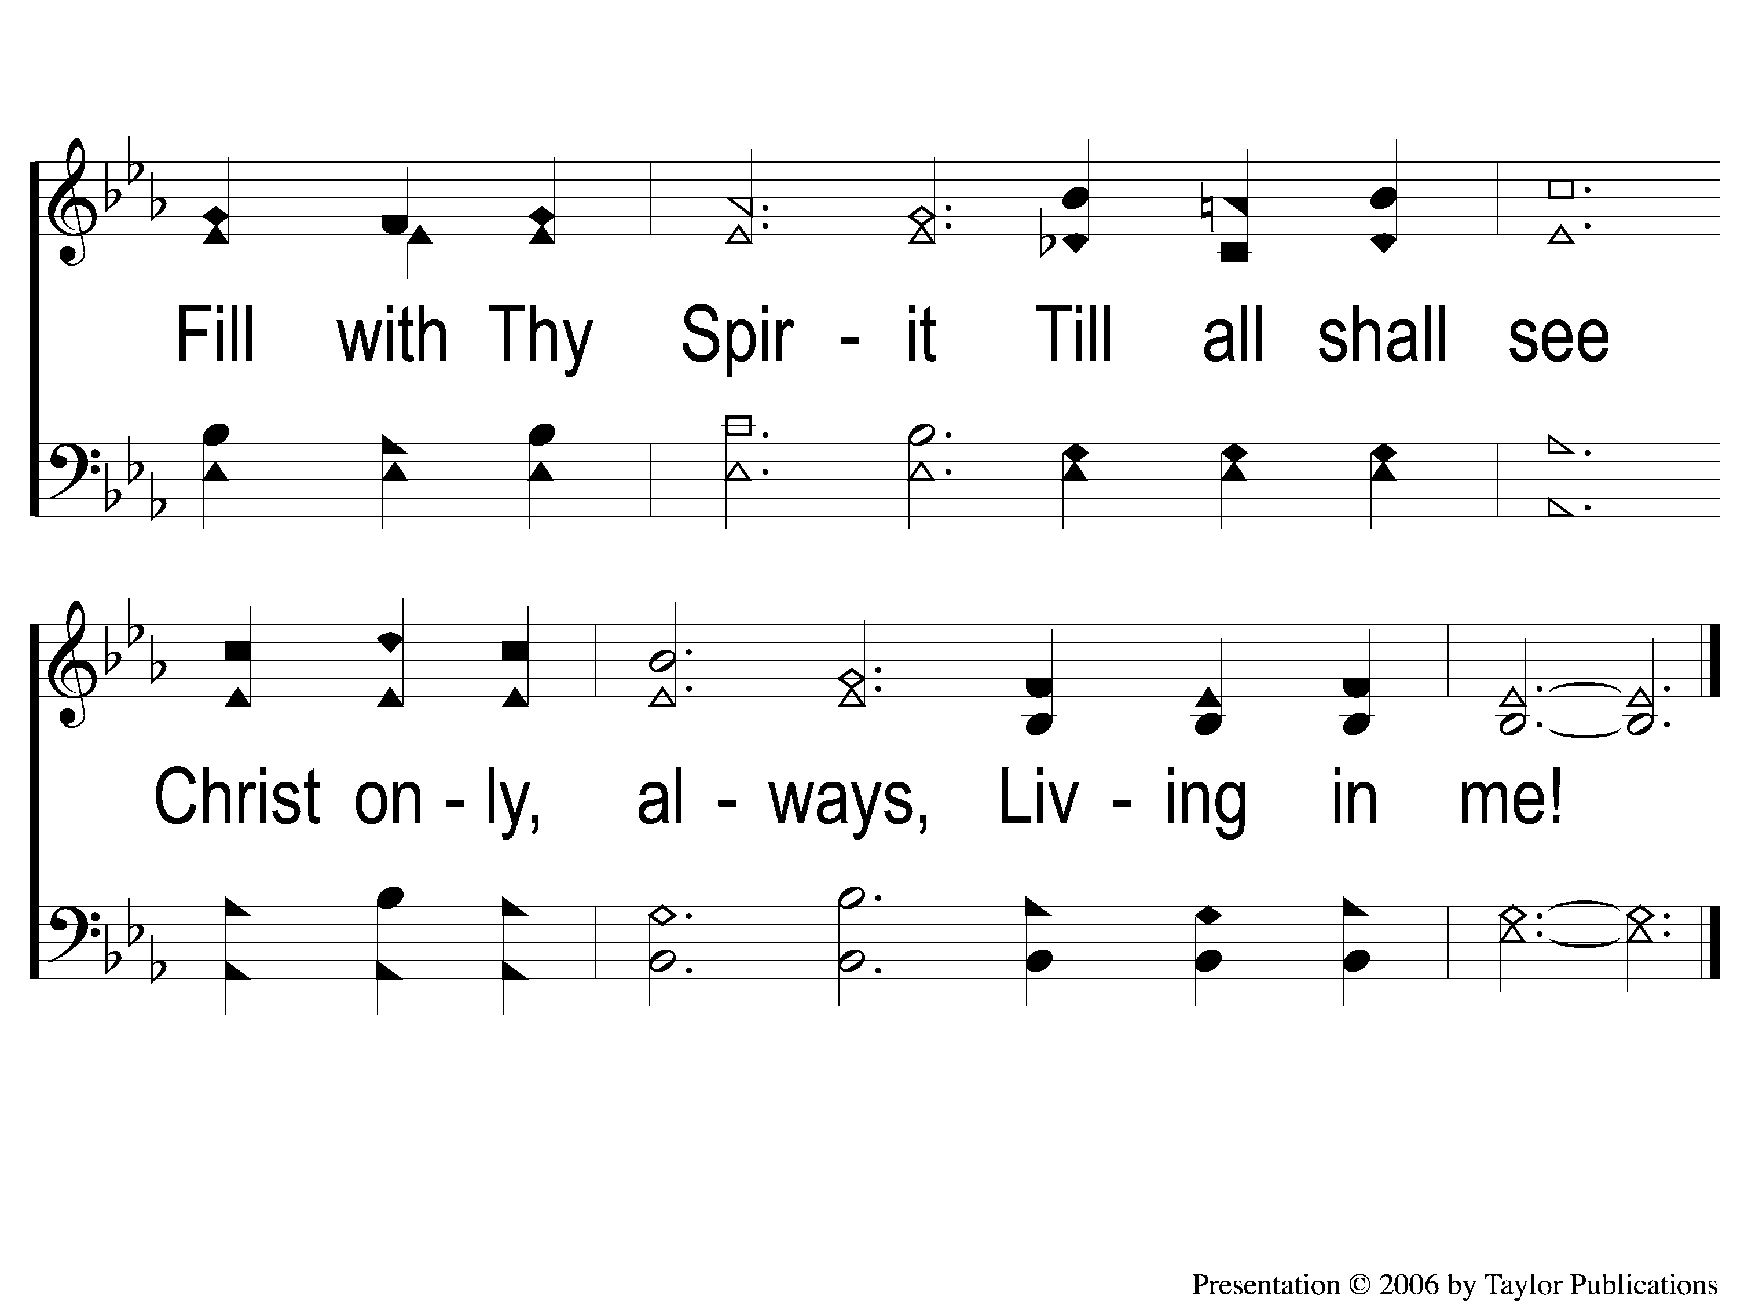
3-2 Have Thine Own Way
Have Thine Own Way
169

